Slide 1

FLL Coach Training
Qualifier Overview & Project

Slide 2
Agenda
Introductions
FIRST® LEGO® League scope
Qualifier Tournaments
General Schedule & Venue Overview
Project

Slide 3


FIRST® LEGO® League
Global Program
9 – 14 year olds
27K+ teams World Wide
Design, build, and program robots
LEGO® MINDSTORMS®
Central Texas
1,600 students
15 school districts

Slide 4

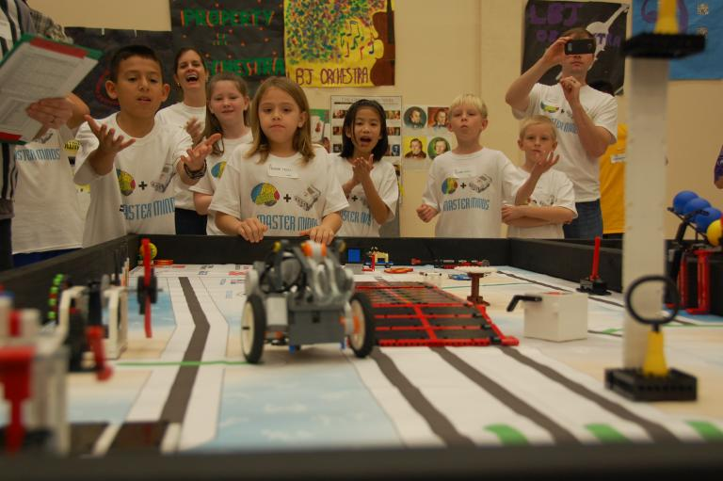
Qualifier Tournaments
Overview:
Each team is invited to ONE (1) qualifier (30 teams)
The top 60 most well-rounded teams will advance to the Invitational Tournament
Qualifier Activities include:
Three Head-to-Head Robot Matches
Judging Sessions
  Robot Design and Programming
  Core Values
  Research Project

Slide 5
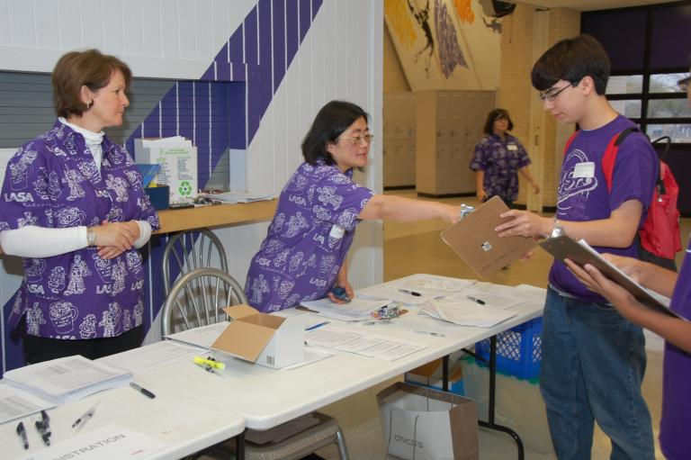
General Schedule
Individual Tournament Experience may vary
7:00 a.m. Volunteer Check-In
7:30 a.m. Team Check-In
7:45 a.m. Judges Meeting
8:15 a.m. Coaches’ Meeting
9:15 a.m. Opening Ceremonies on Tournament Floor
10:00 a.m. Matches and Judging begin
12:00 p.m. Lunch
1:00 p.m. Matches Resume on Tournament Floor
3:00 p.m. Matches End
3:30 p.m. Closing Ceremony on Tournament Floor

Slide 6
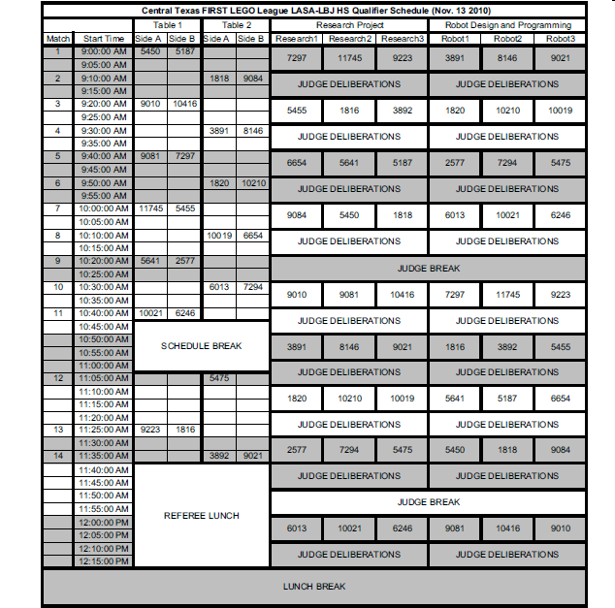
Sample AM Schedule

Slide 7
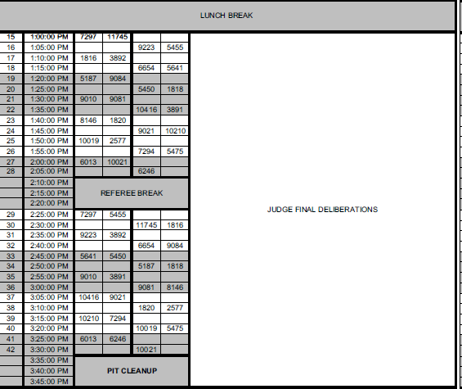
Sample PM Schedule

Slide 8
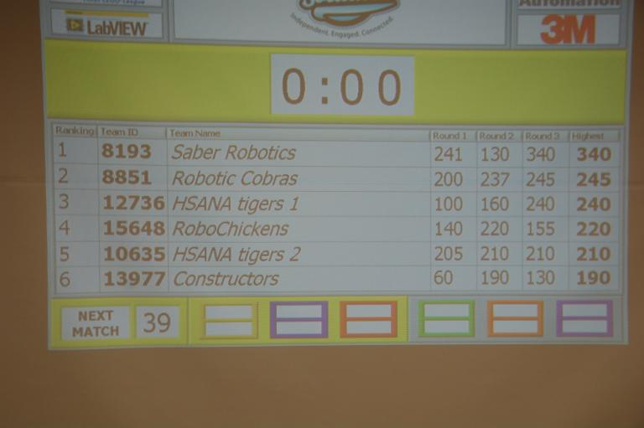
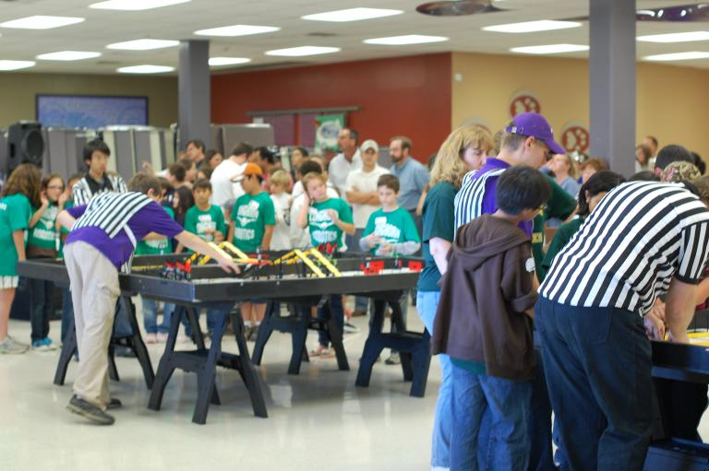
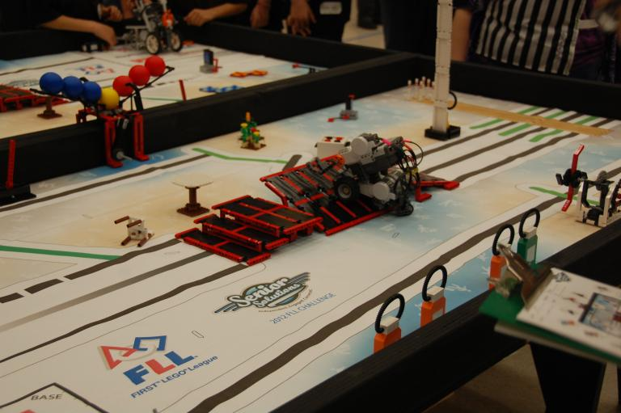
Tournament Floor

Slide 9
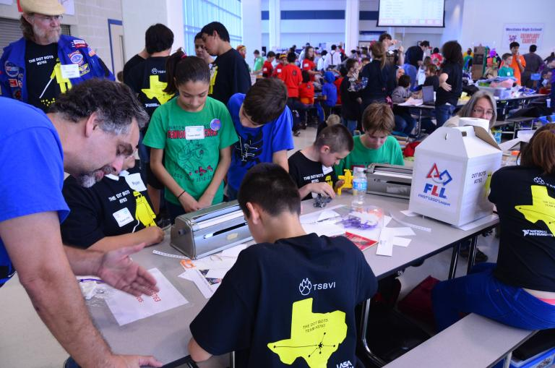
The Pit
Area for team to store their belongings in-between matches and judging sessions
Area to decorate and show the team “Brand”
Parents ARE NOT ALLOWED in the Pit.
Practice tables and charging stations
Teams their own mats and playfields to set up on the practice tables

Slide 10
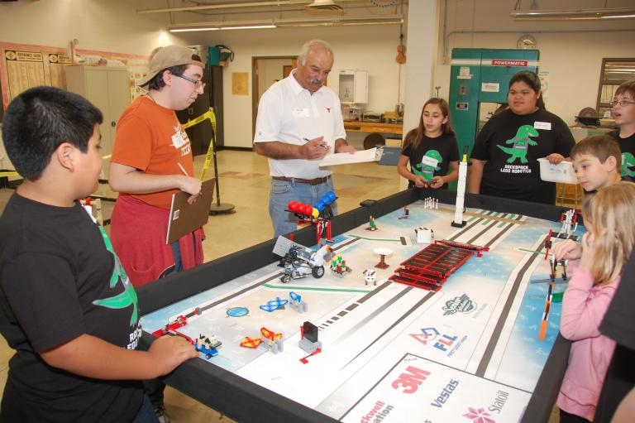
Judging Rooms
Robot Design

Slide 11
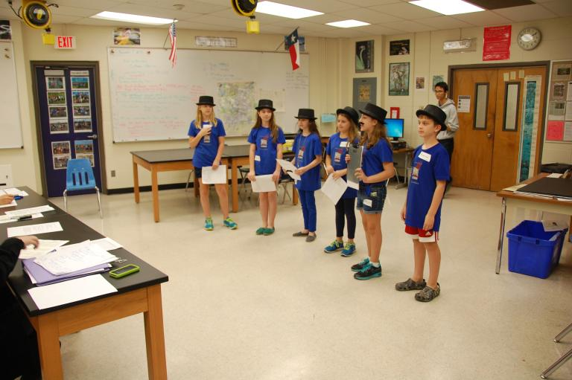
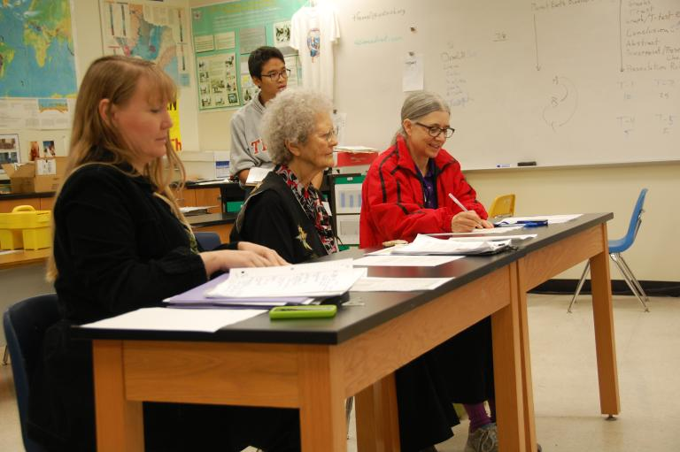
Judging Rooms
Core Values

Slide 12
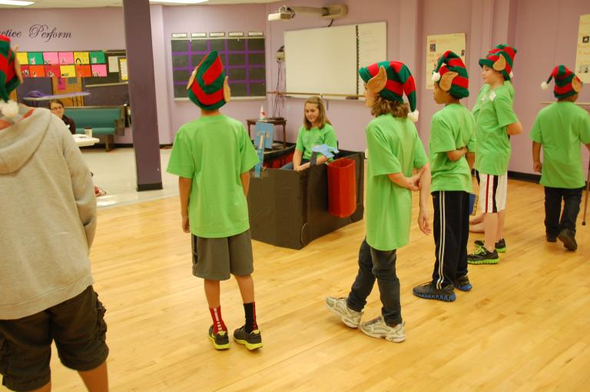
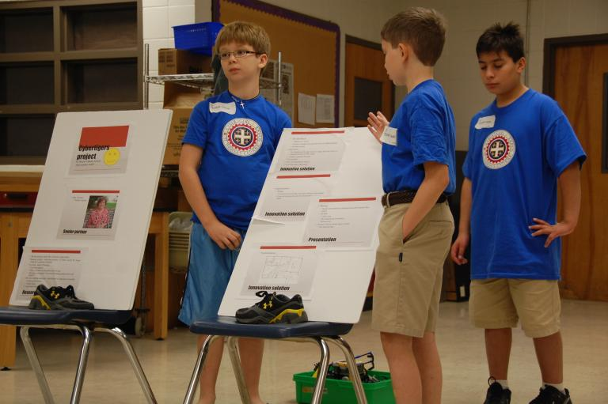
Judging Rooms
Project

Slide 13
Project Judging Format
Length
– 5 minutes, including setup time
– 5 additional minutes for judge questions
Teams may:
– perform a skit
– present PowerPoint
– sing a song
– choose any creative way to share their research

Slide 14
Judging a presentation
To the videos & rubrics!

Slide 15
Project Judge Questions
Project Questions from “Senior Solutions”
What resources did you use for your research, and how did you choose them?
Did you learn anything surprising during the research on the problem that you picked?
How did you come up with the problem that you wanted to address?
How did you come up with your presentation style and content?
Have you shared your research or solution with anyone?
  Why did you pick this group?
How did you pick your senior partner for the research project?

Slide 16
Our Best Advice For the
Season…

Slide 17
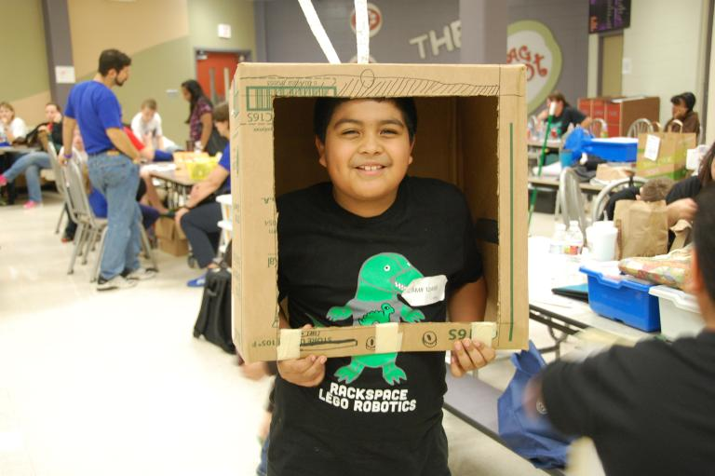
Have Fun!

